Slide 1
Technical Presentation
Heart Disease Prediction Using Machine Learning
M. Nivedha(192471040)
ITA0611-Machine learning

Slide 2
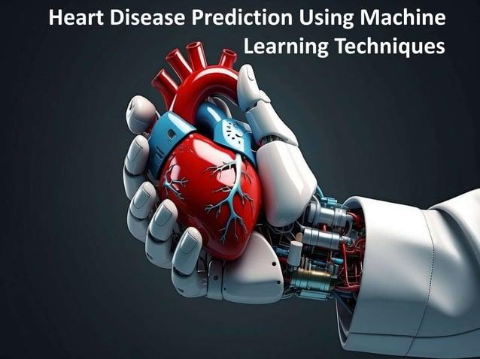
Introduction
Heart disease is a major health problem worldwide.
Early identification of heart disease can help in timely treatment.
Machine Learning can analyze patient health data and find useful patterns.
The system uses medical features to predict the risk of heart disease.
It can support doctors in making faster and data-based decisions.

Slide 3
Problem Statement
Heart disease may not always show clear symptoms in the early stage.
Diagnosis requires analysis of several health-related factors.
Manually analyzing large patient datasets can be time-consuming.
Machine Learning can learn patterns from previous patient records.
The proposed system aims to provide an accurate heart disease risk prediction.

Slide 4
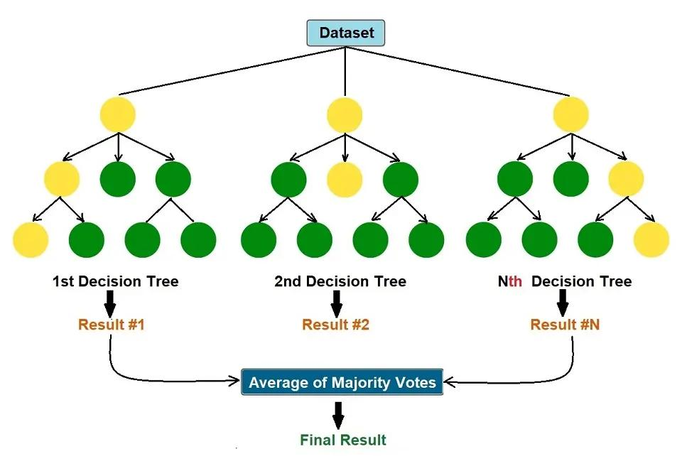
Dataset and Features
Important features:
Age
Sex
Chest pain type
Blood pressure
Cholesterol
Blood sugar
Maximum heart rate
Exercise-induced angina
Target:
0 – No Heart Disease | 1 – Heart Disease

Slide 5
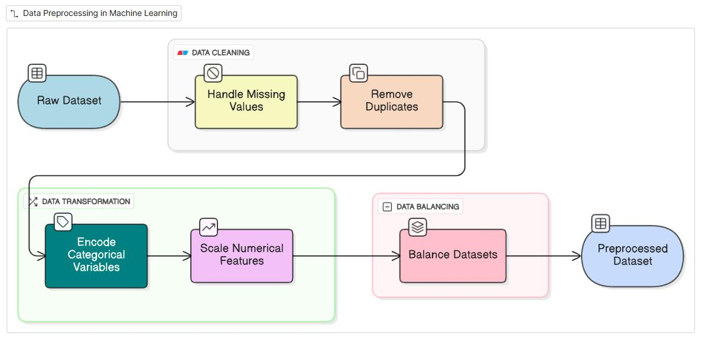
Data Preprocessing
Remove duplicate and incorrect records.
Handle missing values in the dataset.
Convert categorical values into numerical values.
Scale numerical features when required.
Split the dataset into training and testing data.
Flow:
Raw Data → Cleaning → Transformation → Scaling → Train/Test Data

Slide 6
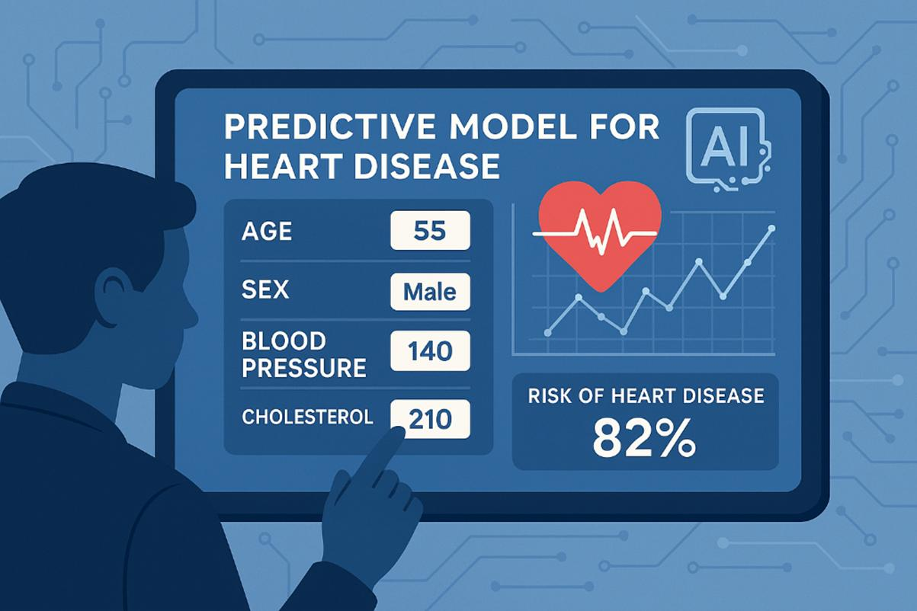
Machine Learning Model
Random Forest Classifier
Random Forest uses multiple decision trees.
Each tree analyzes the patient data independently.
Every tree produces a prediction.
The final result is selected using majority voting.
It provides reliable classification and helps reduce overfitting.
Flow:
Patient Data → Multiple Decision Trees → Voting → Final Prediction

Slide 7
System Methodology
Collect the heart disease dataset
↓
Preprocess the data
↓
Select important features
↓
Train the Random Forest model
↓
Test the model
↓
Predict heart disease risk

Slide 8
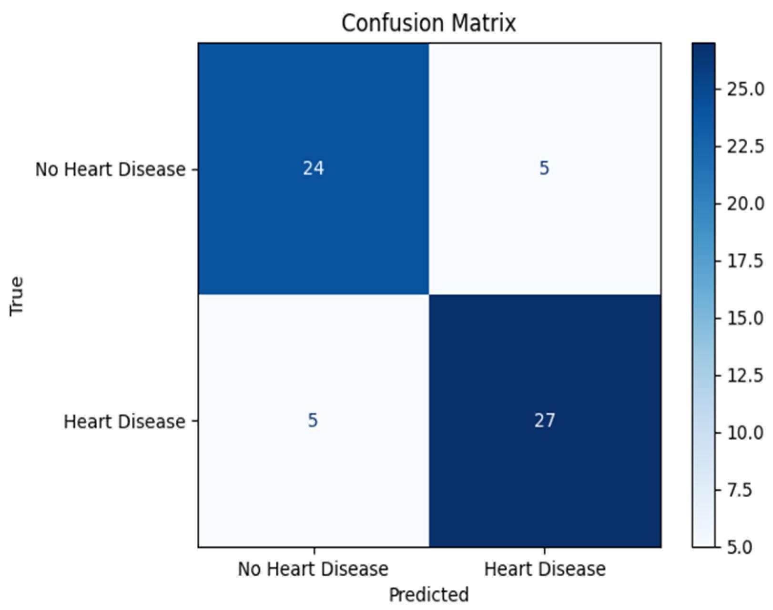
Performance Evaluation
The model is evaluated using:
Accuracy: Measures overall correct predictions.
Precision: Measures how many predicted positive cases are correct.
Recall: Measures how many actual positive cases are detected.
F1-Score: Balances precision and recall.
Confusion Matrix: Shows correct and incorrect predictions.

Slide 9
Results and Advantages
Expected Results:
The model can classify patients into disease and non-disease groups.
Performance is measured using standard evaluation metrics.
Confusion matrix helps understand prediction errors.
Advantages:
Fast analysis of patient data.
Helps identify high-risk cases.
Handles multiple health-related features.
Can be improved using larger datasets.

Slide 10
Future Scope
Use larger and more diverse datasets to improve prediction accuracy.
Integrate real-time patient health data for continuous monitoring.
Apply Deep Learning and advanced ML algorithms for better performance.
Develop a web or mobile application for easy access and prediction.
Improve model explainability so doctors can better understand the prediction results.

Slide 11
Conclusion
Machine Learning can effectively analyze patient health data for heart disease prediction.
Important medical features help the model identify disease-related patterns.
The Random Forest algorithm provides reliable classification results.
Evaluation metrics help measure the accuracy and performance of the system.
The proposed system can support early risk identification and better healthcare decision-making.

Slide 12
Thank you

